Slide 1
Software Design and Architecture
Adapter and Façade Patterns

Slide 2
Design principles
High-level principles
‣ Single Responsibility
‣ Open/Closed
‣ Liskov Substitution Principle
‣ Interface Segregation
‣ Dependency Inversion
Low-level principles
‣ Encapsulate what varies
‣ Program to interfaces, not implementations
‣ Favor composition over inheritance
‣ Strive for loose coupling

Slide 3
Four Design Smells
Rigidity-One change requires many other changes
Fragility-One change breaks other parts
Immobility-Can't pull out a piece to reuse
Needless Repetition-Repeated code is evil, to change the logic, change must happen in many places

Slide 4
Single Responsibility Principle
Every object in your system should have a single responsibility, and all the object’s services should be focused on carrying it out
This is obviously related to the “One Reason to Change” principle:
A class should have only one reason (design-related reason ) to change.
If you have implemented SRP correctly, then each class will have only one reason to change.

Slide 5
Example
Often we need to sort students by their name, or ssn. So one may make Class Student implement the Java Comparable interface.
class Student implements Comparable {
…
int compareTo(Object o) { … }
…
};
Student is a business entity, it does not know in what order it should be sorted since the order of sorting is imposed by the client of Student.
Worse: every time students need to be ordered differently, we have to recompile Student and all its client.
Cause of the problems: we bundled two separate responsibilities (i.e., student as a business entity with ordering) into one class – a violation of SRP

Slide 6
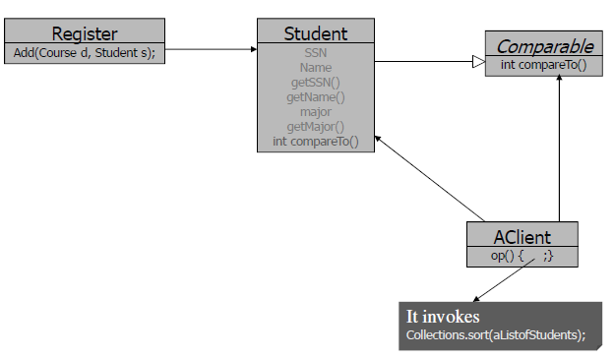
Example
When a new requirement needs to sort students in a different order, Student, Register, and AClient all need to be recompiled, even Register has nothing to do with any ordering of Students.

Slide 7
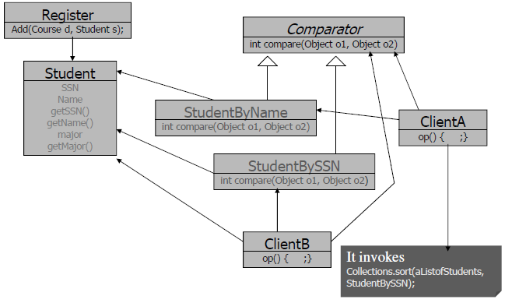
Example
The solution is to separate the two responsibilities into two separate classes and use another version of Collections.sort().

Slide 8
Liskov Substitution Principle
Subtypes must be substitutable for their base types
Basic Idea
Instances of subclasses do not violate the behaviors exhibited by instances of their superclasses
They may constrain that behavior but they do not contradict that behavior
LSP is about well-designed inheritance

Slide 9
Example
public class Rectangle {
private double width, height;
public Rectangle() {
}
Rectangle(double w, double h) {
width = w;
height = h;
}
public double area() {
return width * height;
}
public void setWidth(double w) {
width = w;
}
public void setHeight(double h) {
height = h;
}
public double getWidth() {
return width;
}
public double getHeight() {
return height;
}
}
public class Square extends Rectangle {
Square(double s) {
super(s, s);
}
}
public class TestLSP {
public static void main(String[] args) {
Rectangle r = new Rectangle(); // Returns the rectangle type object
r.setWidth(5);
r.setHeight(4);
System.out.println(r.area()==20);
Rectangle s = new Square(5); // Returns the square type object
System.out.println(s.area());
s.setHeight(10);
System.out.println(s.getWidth()==10);//? False why?
System.out.println(s.area());//? 50 why?
}
}

Slide 10
Solution to the “Squareness” Problem
public class Square extends Rectangle {
Square(double s) {
super(s, s);
}
public void setWidth(double w) {
super.setWidth(w); super.setHeight(w);
}
public void setHeight(double h) {
super.setWidth(h); super.setHeight(h);
}
}
public class Rectangle {
private double width, height;
public Rectangle() {
}
Rectangle(double w, double h) {
width = w;
height = h;
}
public double area() {
return width * height;
}
public void setWidth(double w) {
width = w;
}
public void setHeight(double h) {
height = h;
}
public double getWidth() {
return width;
}
public double getHeight() {
return height;
}
}
public class TestLSP {
public static void main(String[] args) {
Rectangle r = new Rectangle(); // Returns the rectangle type object
r.setWidth(5);
r.setHeight(4);
System.out.println(r.area()==20);
Rectangle s = new Square(5); // Returns the square type object
System.out.println(s.area());
s.setHeight(10);
System.out.println(s.getWidth()==10);//?
System.out.println(s.area());//?
}
}

Slide 11
The Problem of using the Solution with Square Object
public class Rectangle {
private double width, height;
public Rectangle() {
}
Rectangle(double w, double h) {
width = w;
height = h;
}
public double area() {
return width * height;
}
public void setWidth(double w) {
width = w;
}
public void setHeight(double h) {
height = h;
}
public double getWidth() {
return width;
}
public double getHeight() {
return height;
}
}
public class Square extends Rectangle {
public Square() {
}
Square(double s) {
super(s, s);
}
public void setWidth(double w) {
super.setWidth(w); super.setHeight(w);
}
public void setHeight(double h) {
super.setWidth(h); super.setHeight(h);
}
}
public class TestLSPSquare {
public static void areaCalculator(Rectangle r){
r.setWidth(5);
r.setHeight(4);
System.out.println(r.area()==20);
}
public static void main(String[] args) {
Rectangle s = new Square();
areaCalculator(s);
}
}

Slide 12
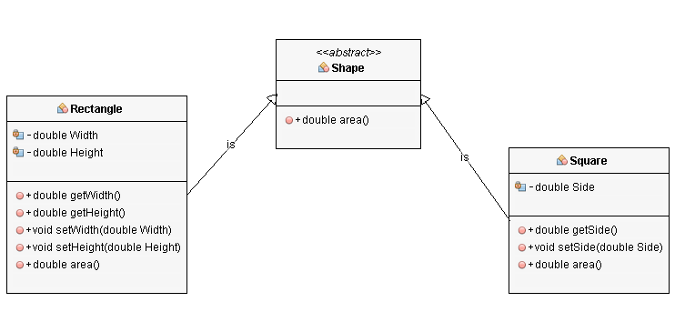
The Design without Violating LSP
public abstract class Shape
{
public abstract double area();
}
public class Rectangle extends Shape {
private double Width;
private double Height;
public double getWidth() {
return Width;
}
public double getHeight() {
return Height;
}
public void setWidth(double Width) {
this.Width = Width;
}
public void setHeight(double Height) {
this.Height = Height;
}
@Override
public double area() {
return this.getWidth()*this.getHeight();
} }
public class Square extends Shape {
private double Side;
public double getSide() {
return Side;
}
public void setSide(double Side) {
this.Side = Side;
}
@Override
public double area() {
return this.getSide()*this.getSide();
}
}

Slide 13
The Design Violating LSP
public class Graph2D {
public void draw(int x, int y) {
System.out.println("drawing a 2D co-ordinate");
}
}
public class Graph3D extends Graph2D{
public void draw(int x, int y, int z){
System.out.println("drawing a 3D co-ordinate");
}
}
public class Plotter {
public static void main(String[] args) {
Graph3D graph = new Graph3D();
graph.draw(4, 4, 5);
}
}
Graph3D extends Graph2D and hence it also has draw(int x, int y) method, and the call graph.draw(4 , 4); is also valid. When we call graph.draw(4.4) its not really drawing a 3D graph and it does not make sense at all. It is violation of LSP.

Slide 14
The Design with Delegation
public class Graph2D {
public void draw(int x, int y) {
System.out.println("drawing a 2D co-ordinate");
}
}
public class Graph3D {
private Graph2D graph2d = new Graph2D();
public void draw(int x, int y, int z){
graph2d.draw(x, y);
System.out.println("drawing a 3D co-ordinate");
}
}
public class Plotter {
public static void main(String[] args) {
Graph3D graph = new Graph3D();
graph.draw(4, 4, 5);
}
}
Now we cannot call draw(int x, int y) method on a Graph3D object which helps in reducing confusing code and solving violation of LSP.

Slide 15
Interface Segregation Principle
Clients should not be forced to depend on methods that they do not use.
When we bundle functions for different clients into one interface/class, we create unnecessary coupling among the clients.
When one client causes the interface to change, all other clients are forced to recompile.

Slide 16
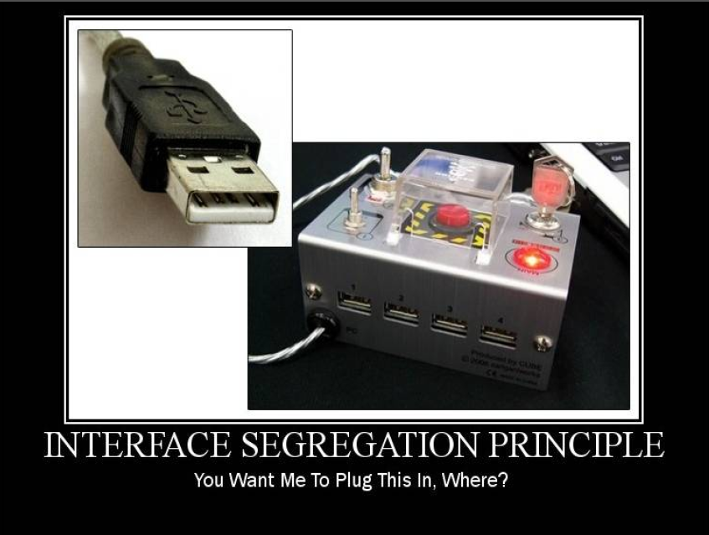

Slide 17
Example
Java has two interfaces for mouse events, one for common mouse events (MouseListener) and one for motion events (MouseMotionListener). Grouping all events into one interface would have violated the ISP.
interface MouseListener { void mouseClicked(MouseEvent e); void mousePressed(MouseEvent e); void mouseReleased(MouseEvent e); void mouseEntered(MouseEvent e); void mouseExited(MouseEvent e); }
interface MouseMotionListener { void mouseDragged(MouseEvent e); void mouseMoved(MouseEvent e); }

Slide 18
The Design Violating ISP
public interface Athlete {
void compete();
void swim();
void highJump();
void longJump();
}
public class JohnDoeSwimmet implements Athlete {
@Override
public void compete() {
System.out.println("John Doe started competing");
}
@Override
public void swim() {
System.out.println("John Doe started swimming");
}
@Override
public void highJump() {
}
@Override
public void longJump() {
}
}
public class JoeJumper implements Athlete { }//?
When one client causes the interface to change, all other clients are forced to recompile.

Slide 19
The Design with ISP
public interface Athlete {
void compete();
}
public interface SwimmingAthlete extends Athlete {
void swim();
}
public interface JumpingAthlete extends Athlete {
void highJump();
void longJump();
}
public class JohnDoeSwimmer implements SwimmingAthlete {
@Override
public void compete() {
System.out.println("John Doe started competing");
}
@Override
public void swim() {
System.out.println("John Doe started swimming");
}
}
public class JoeJumper implements Athlete { } //?

Slide 20
Adapter
Behavioral Patterns
observer
decorator
strategy
command
template
Creational Patterns
factory method
abstract factory
singleton
Structural Patterns ~ ease design by identifying a simple way to realize relationships between entities
adapter

Slide 21
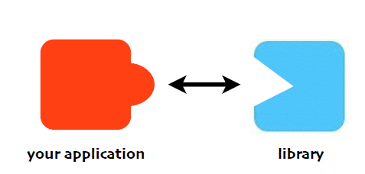
Problem
Interface Incompatibility, and you
{cannot, don’t want to} change the
interface of the library you want to use

Slide 22
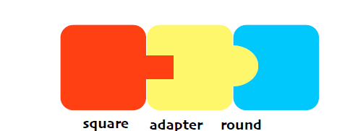
Adapter / Wrapper
The Adapter Pattern converts the
interface of a class into another
interface the client expects.

Slide 23
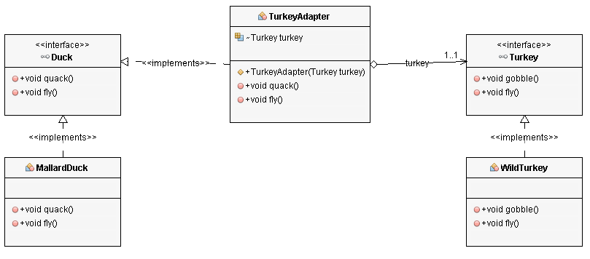
Example
A turkey hiding among ducks!
If it walks like a duck and quacks like a duck, then it must be a duck!

Slide 24
Code
1. Adapter implements target interface (Duck).
2. Adaptee (turkey) is passed via constructor and stored internally
3. Calls by client code are delegated to the appropriate methods in the adaptee
4. Adapter is full-fledged class, could contain additional vars and methods to get its job done
public class TurkeyAdapter implements Duck {
Turkey turkey;
public TurkeyAdapter(Turkey turkey) {
this.turkey = turkey;
}
public void quack() {
turkey.gobble();
}
public void fly() {
for(int i=0; i < 5; i++) {
turkey.fly();
}
}
}

Slide 25
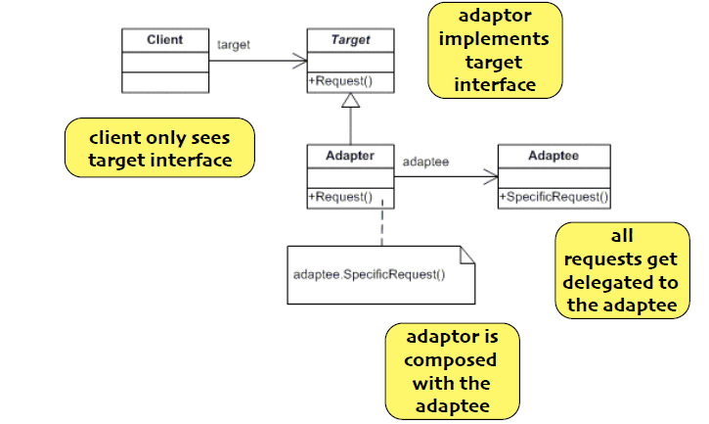
Object Adapter

Slide 26
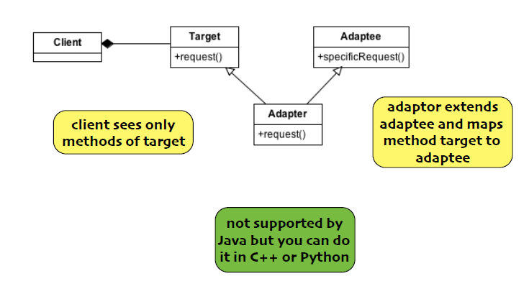
Class Adapter
Requires use of multiple inheritance, but now adapter does not need to re-implement target and/or adaptee behavior.
It simply overrides or inherits that behavior instead.

Slide 27
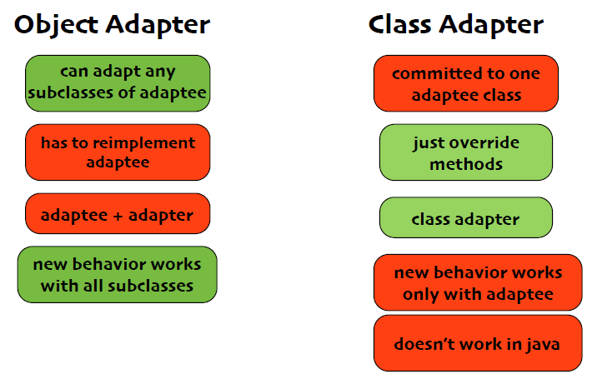
Tradeoffs

Slide 28
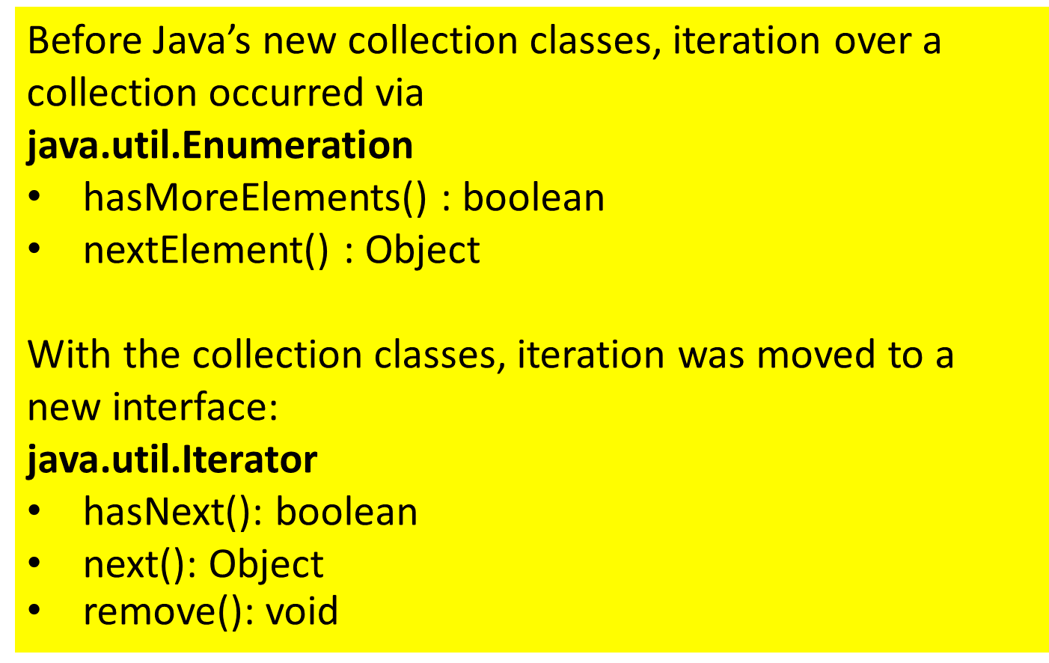
Real World Adapters

Slide 29
Difference between Adapter and Decorator
They both wrap objects at run-time.
They both delegate requests to their wrapped objects.
How are they different?
Adapter converts one interface into another while maintaining functionality
Decorator leaves the interface alone but adds new functionality
Decorators are designed to be “stacked”; that’s less likely to occur with adapters

Slide 30
Facade
Behavioral Patterns
observer
decorator
strategy
command
template
Creational Patterns
factory method
abstract factory
singleton
Structural Patterns
adapter
facade

Slide 31
Problem
Lots of different interfaces, and too much low level complexity

Slide 32
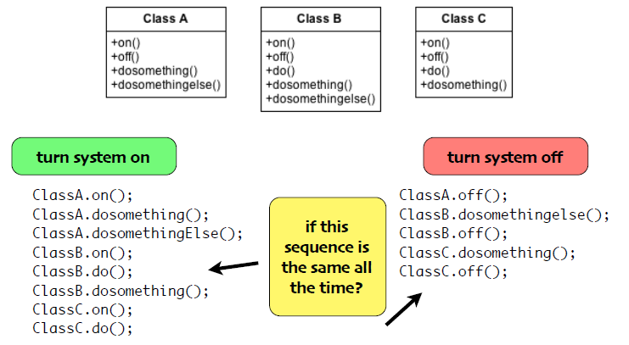
Example

Slide 33
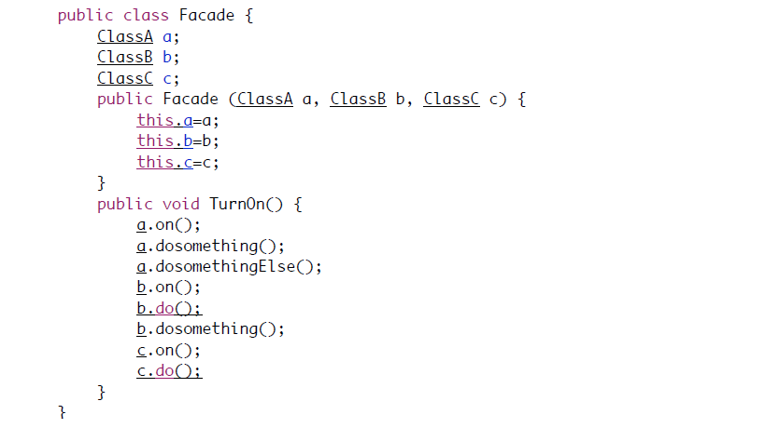
Build a simpler interface

Slide 34
Facade
The Facade pattern provides a unified
interface to a set of interfaces in a subsystem. Facade defines a higher level interface that make the subsystem easier to use.

Slide 35
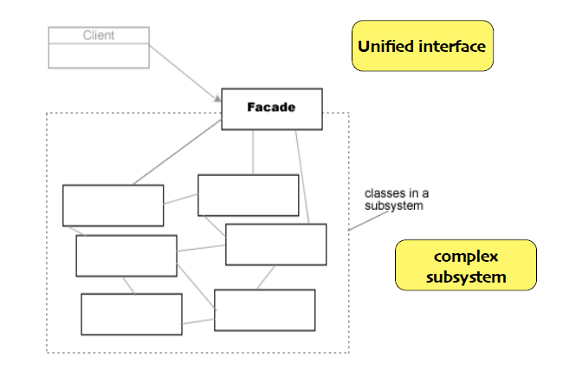
Class Diagram

Slide 36
Difference with Adapter
Intent:
Adapter changes the interface
Facade simplifies the interface

Slide 37
Design Principle
Principle of Least Knowledge:
Talk only to your immediate friends

Slide 38
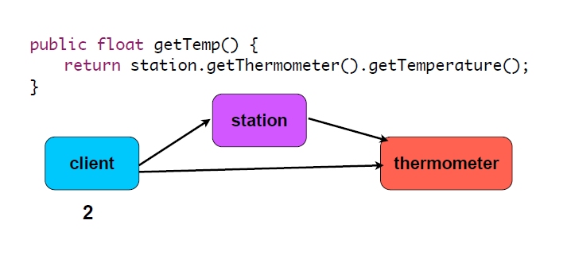
Not this

Slide 39
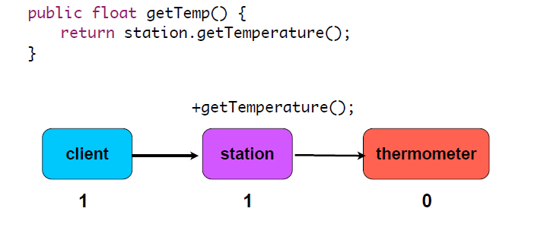
But this

Slide 40
Law of Demeter
Only invoke methods that belong to
the object itself
objects passed as a parameter
any object that the method creates
any component of the object

Slide 41
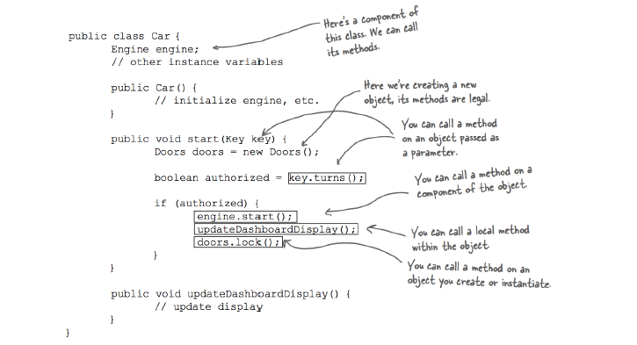
Example

Slide 42
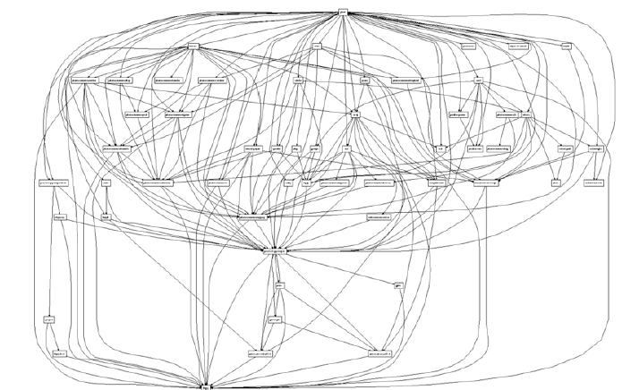
Avoid Spaghetti

